Slide 1
Datathon 1: Analysis of Lung Cancer and BMI Risk Factors
Priyonto Saha, Kinna Zhao, Yacine Marouf

Slide 2
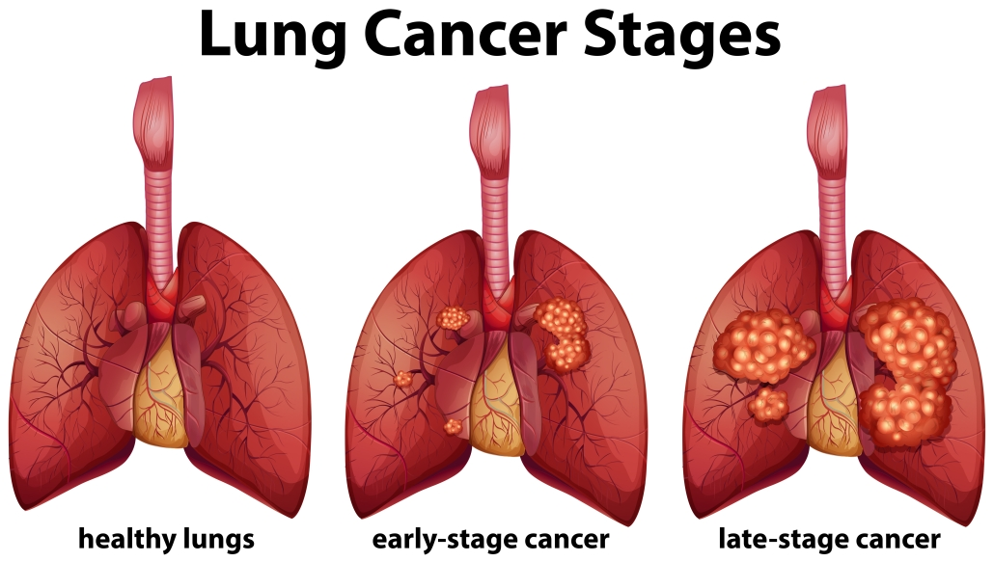
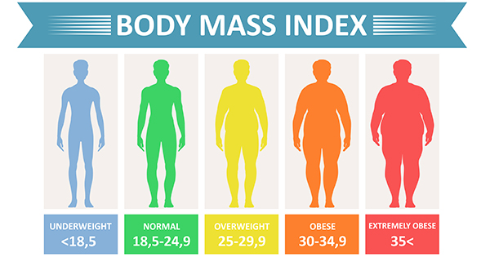
Objectives
1) Analyse and visualise the descriptive statistics of a lung cancer dataset from Ethiopia and a BMI dataset from Canada.
2) Predict the possible severity of cancer and rate of obesity through the use of linear regressions and K-nearest-neighbours on multiple risk factors.
3) If possible, determine any possible environmental, behavioural, and physical similarities between varying lung cancer patients and people with varying BMIs through the use of K means unsupervised learning.

Slide 3
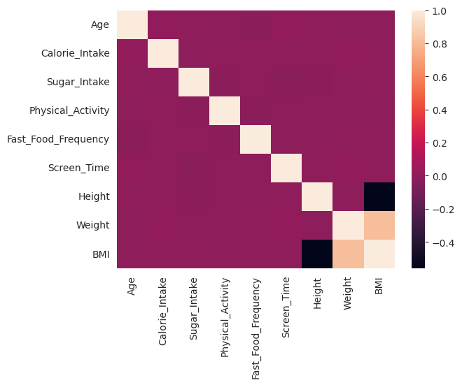
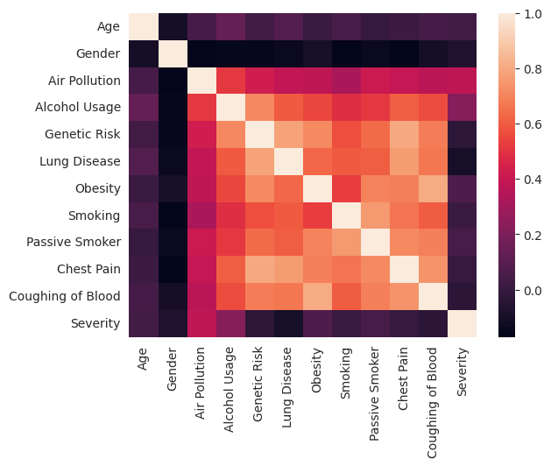
Visualisation and preprocessing
BMI dataset
Lung cancer dataset

Slide 4
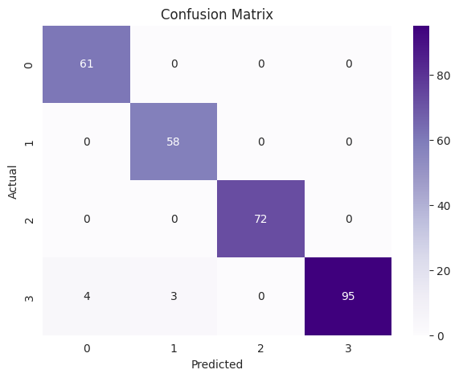
Results and analysis
0 is Low Severity, 1 is Medium Severity,
2 is High Severity, 3 is Healthy.
class | precision | recall | f1-score | support
0 | 0.97 | 1.00 | 0.98 | 56
1 | 1.00 | 1.00 | 1.00 | 71
2 | 1.00 | 1.00 | 1.00 | 75
3 | 1.00 | 0.98 | 0.99 | 91
accuracy |  |  | 0.99 | 293
Macro avg | 0.99 | 0.99 | 0.99 | 293
Micro avg | 0.99 | 0.99 | 0.99 | 293
KNN on Cancer dataset with K = 2.

